Slide 1
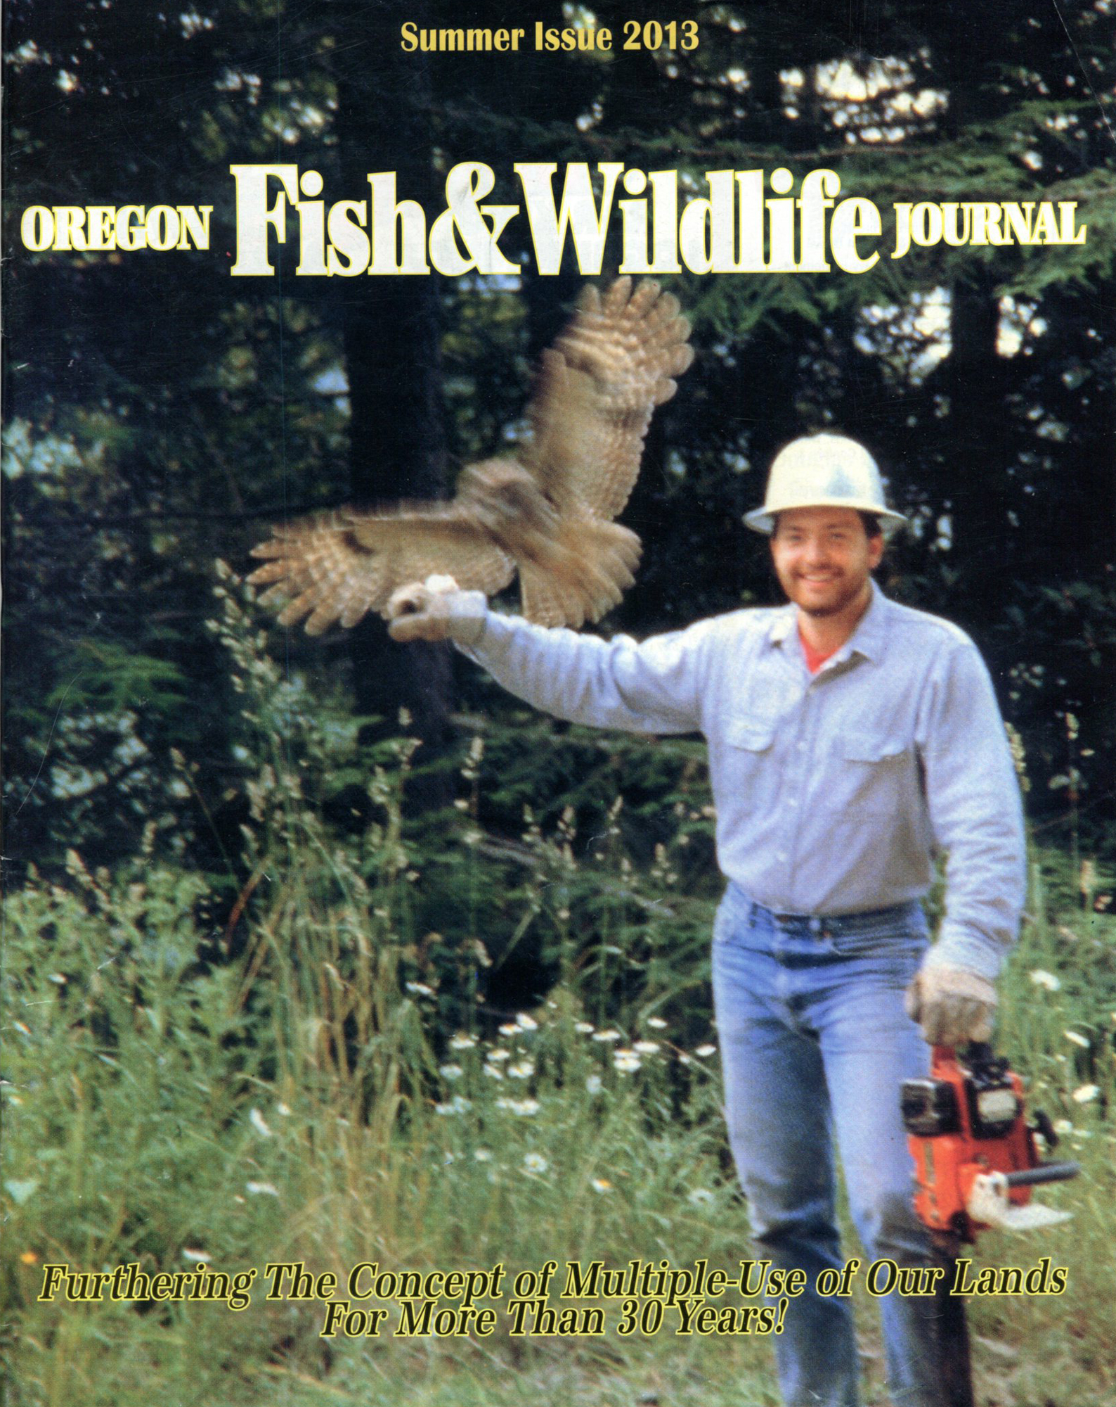
Spotted Owls and the Spotty Sciences That Spawned Them
Presented by Dr. Bob Zybach, PhD. Environmental Sciences
FES 507 Fall 2013 Graduate Student Seminar: “Advocacy in Science; Science in Advocacy”
Oregon State University, Corvallis, Oregon, December 5, 2013

Slide 4
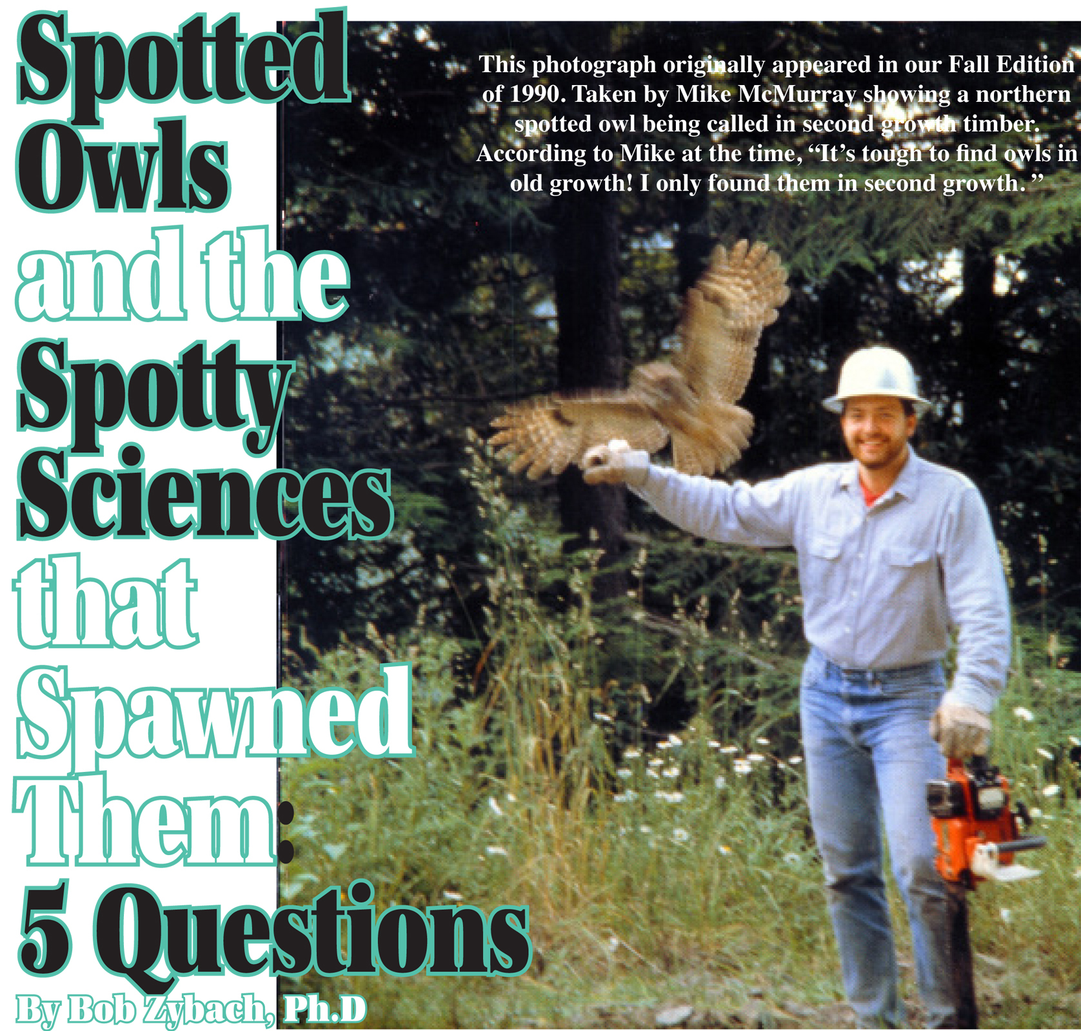

Slide 5
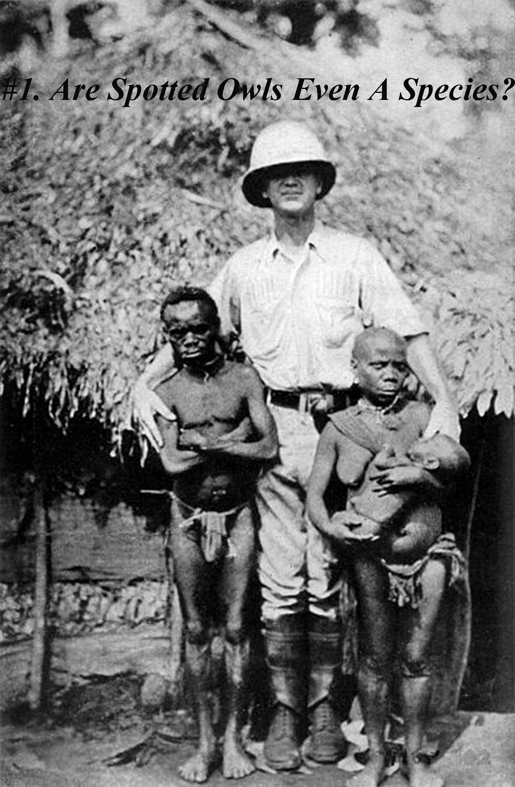

Slide 6
Finally, varieties cannot be distinguished from species, -- except, first, by the discovery of intermediate linking forms; and, secondly, by a certain indefinite amount of difference between them; for two forms, if differing very little, are generally ranked as varieties, notwithstanding that they cannot be closely connected; but the amount of difference considered necessary to give any two forms the rank of species cannot be defined.
--Charles Darwin, The Origin of Species, 1859.

Slide 7
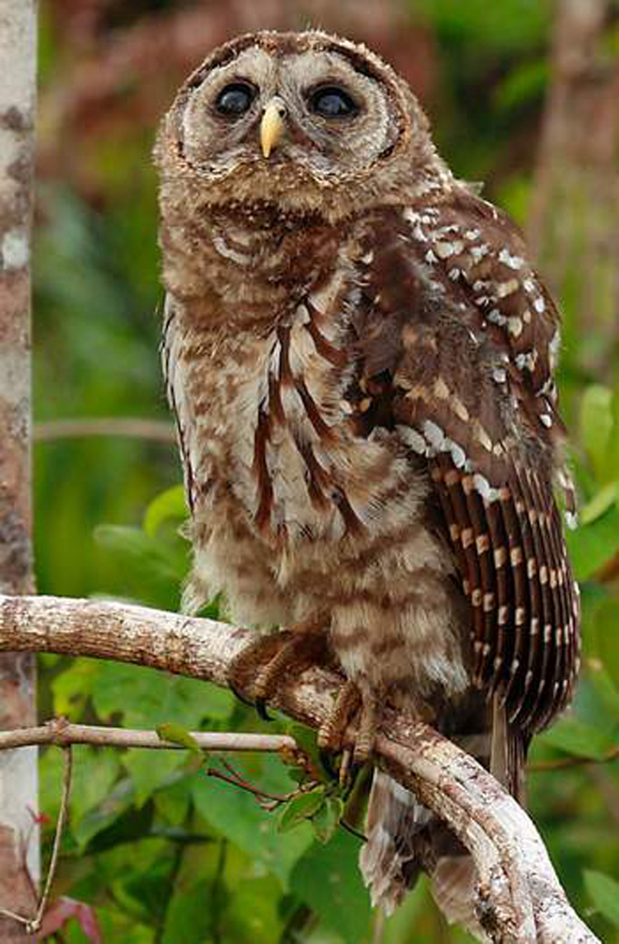

Slide 8
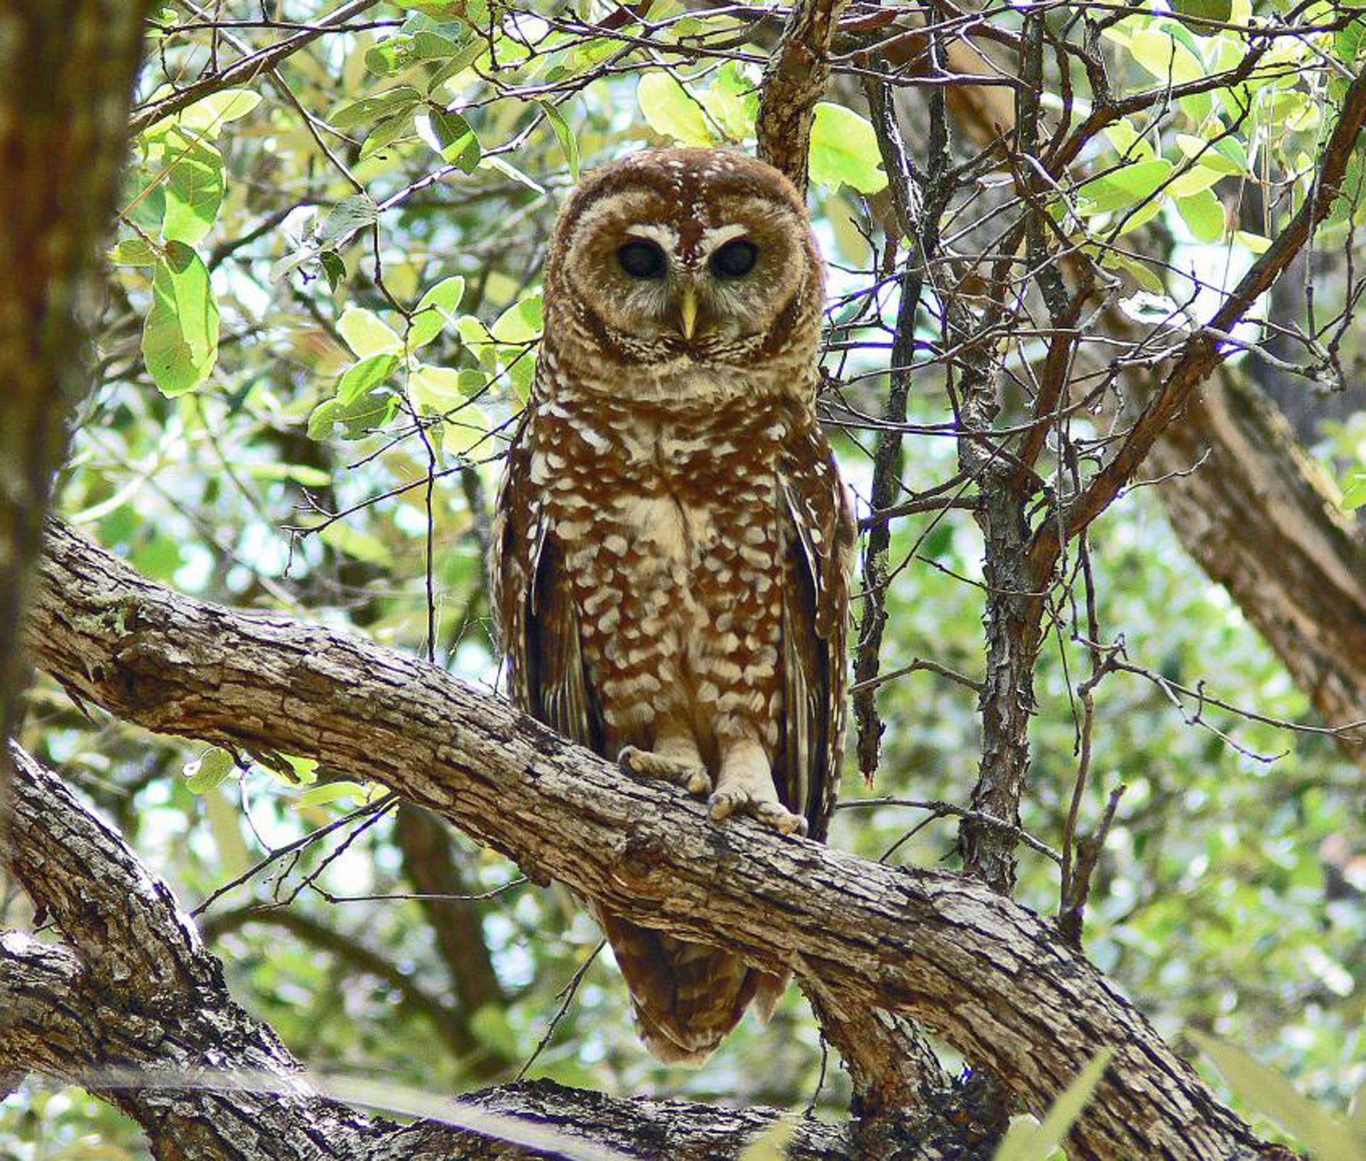

Slide 9
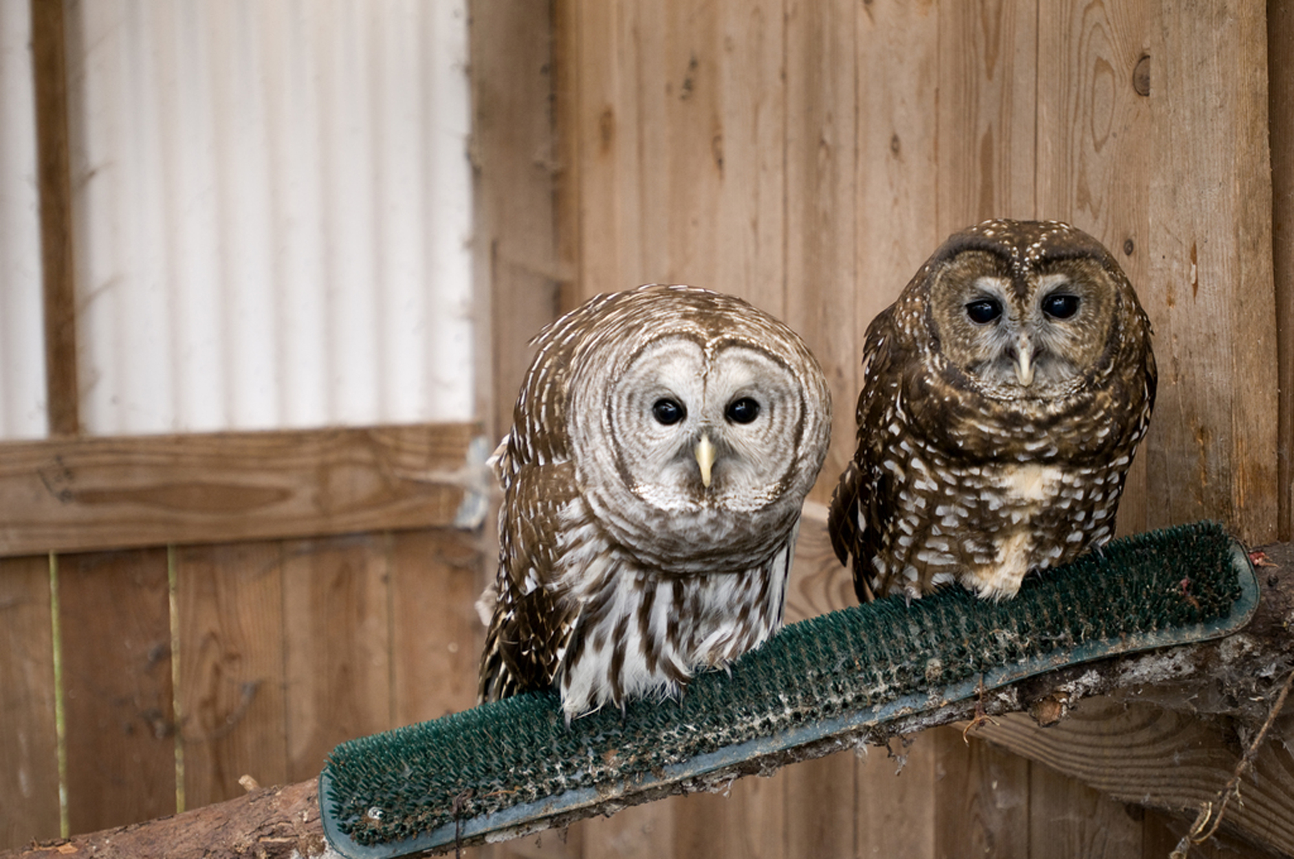

Slide 10
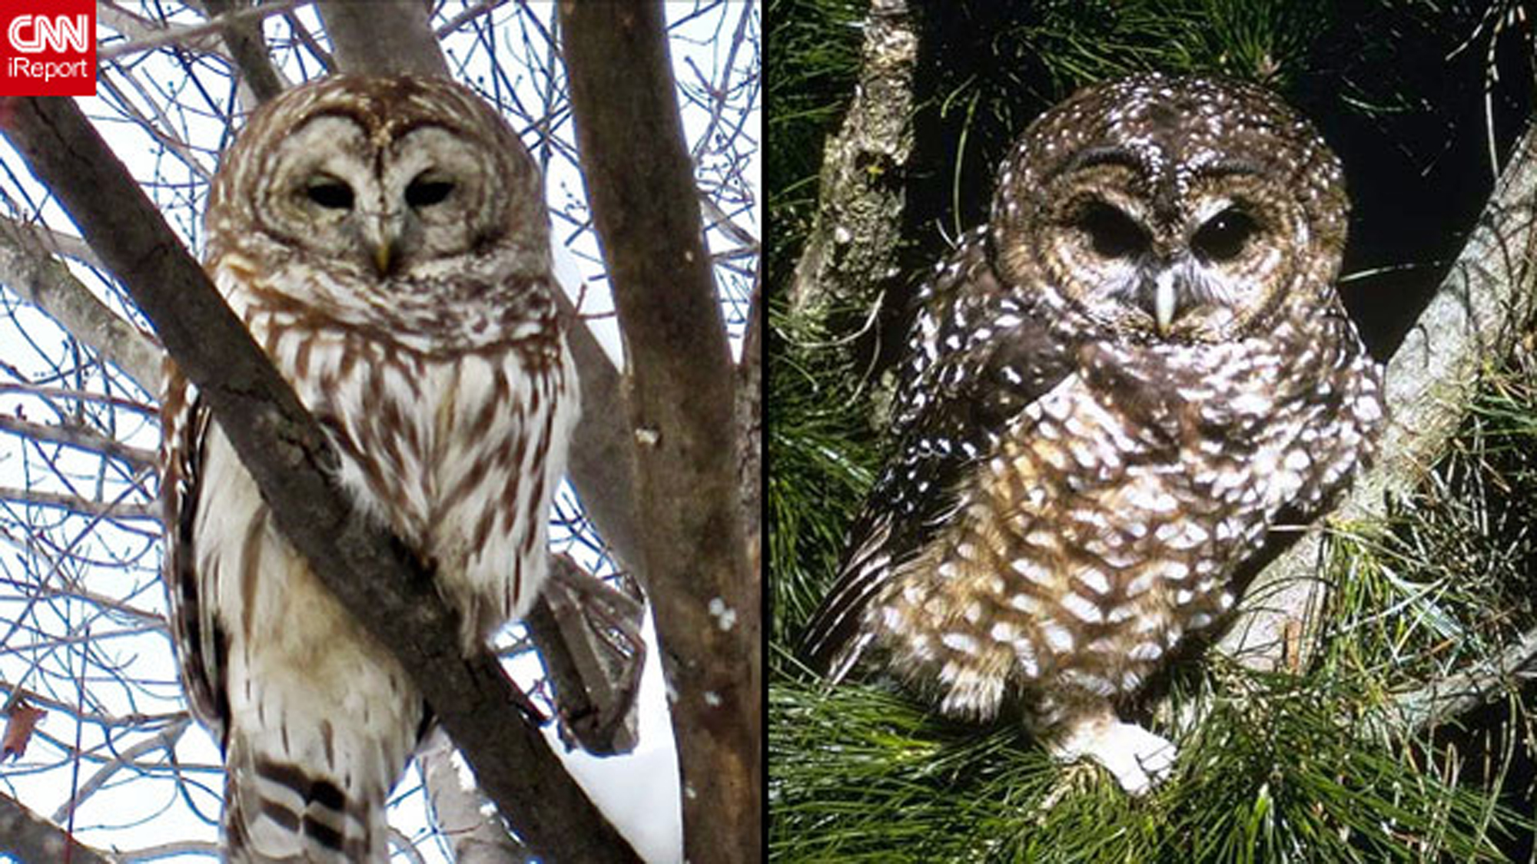

Slide 11
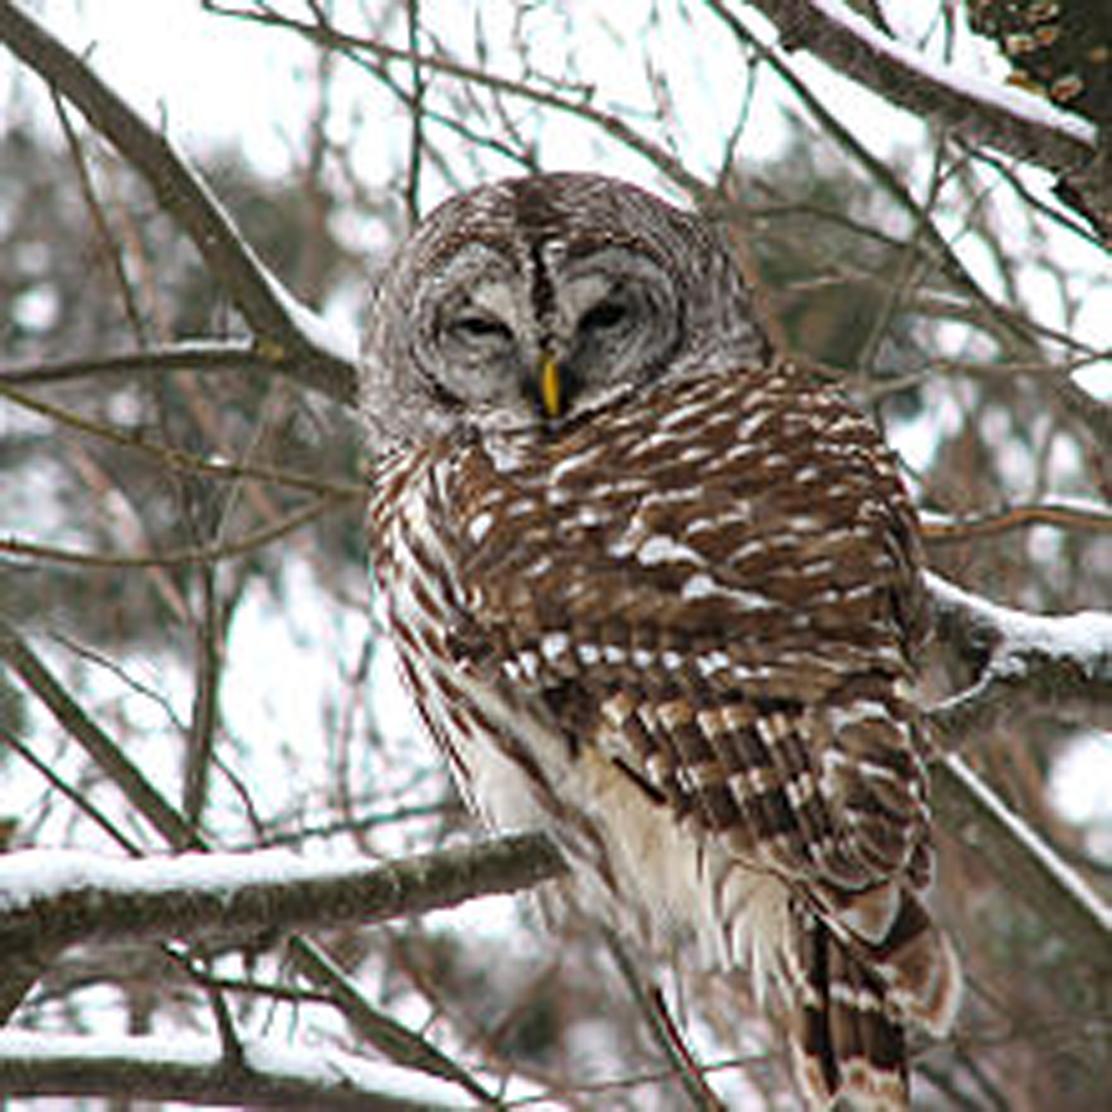
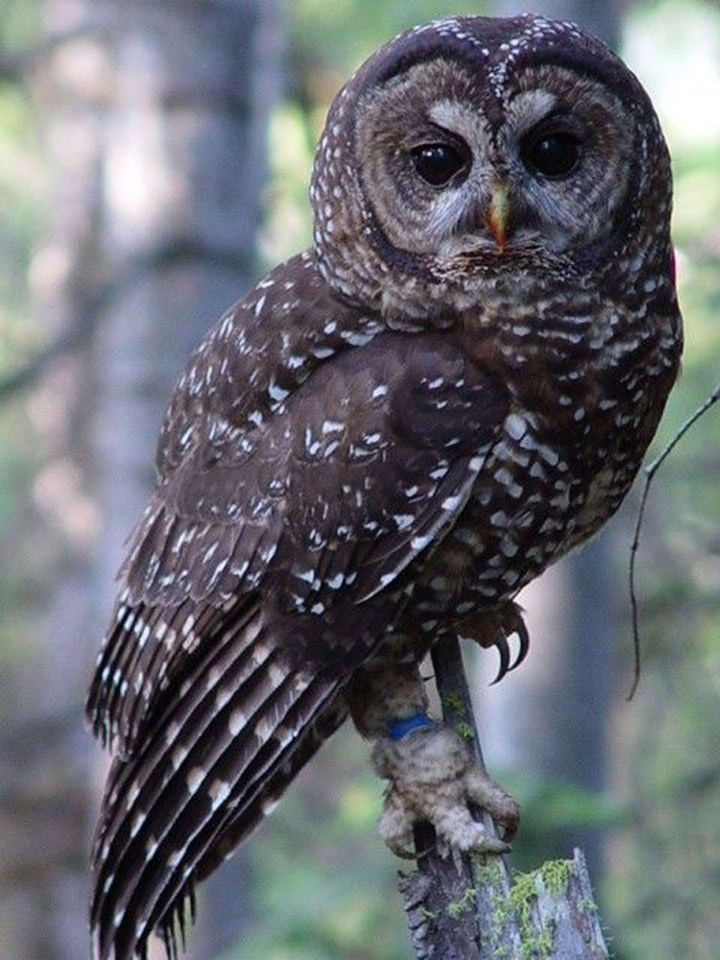
Hoot Owl vs. USDA NSO
Physiology
Coloration
Feather Markings
Vocalizations
Diet
Preferred Habitat
Mating Rituals
Viable Offspring
Hoot Owl
USDA NSO

Slide 12
Pygmy vs. Swede
Physiology
Coloration
Hair Texture
Vocalizations
Diet
Preferred Habitat
Mating Rituals
Viable Offspring

Slide 14
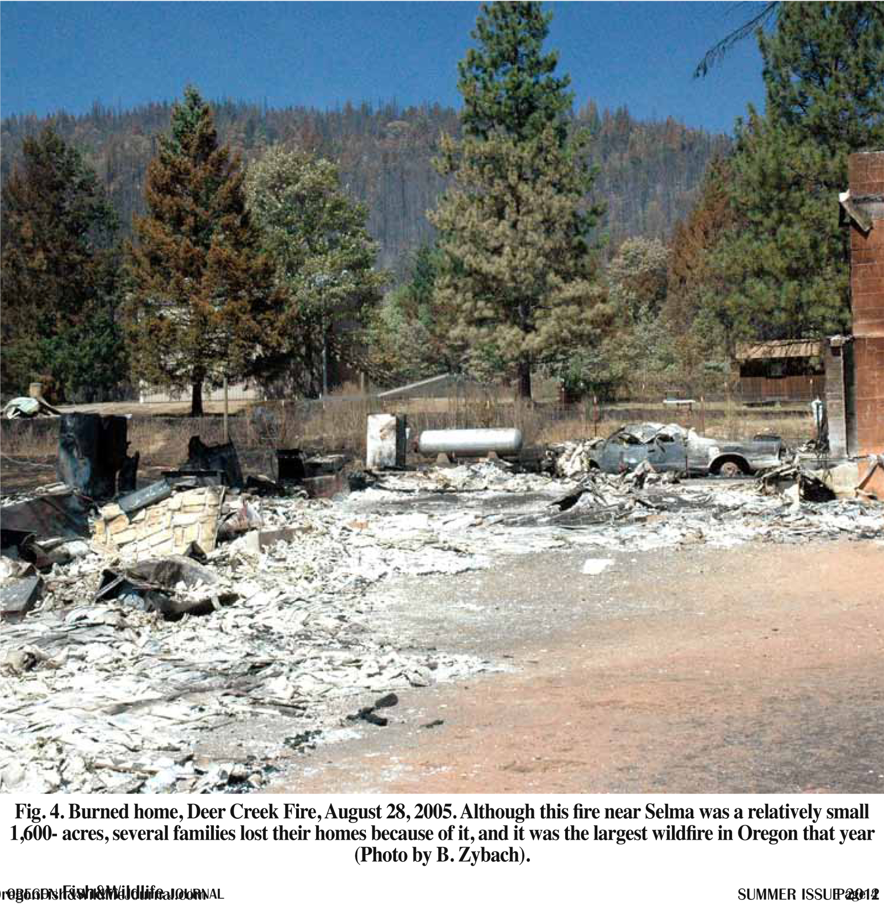

Slide 15
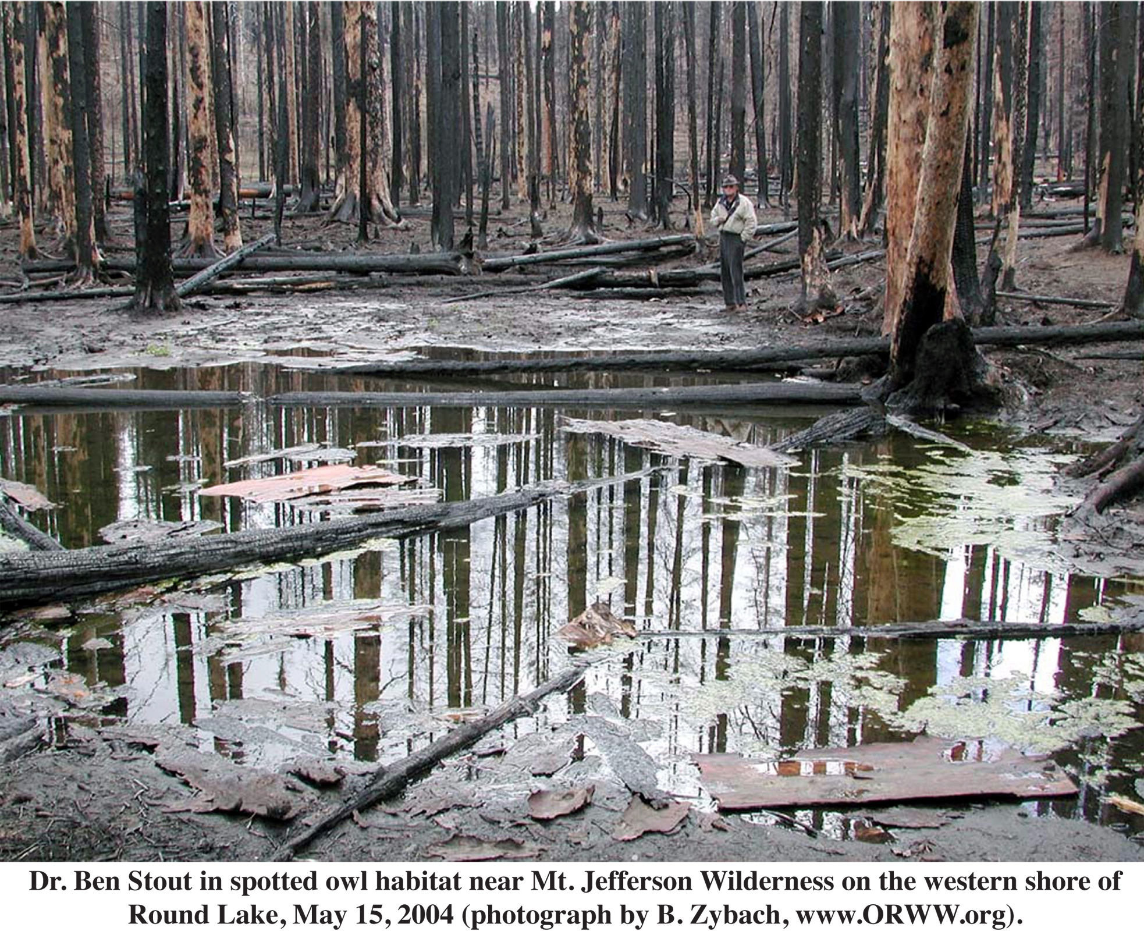

Slide 16
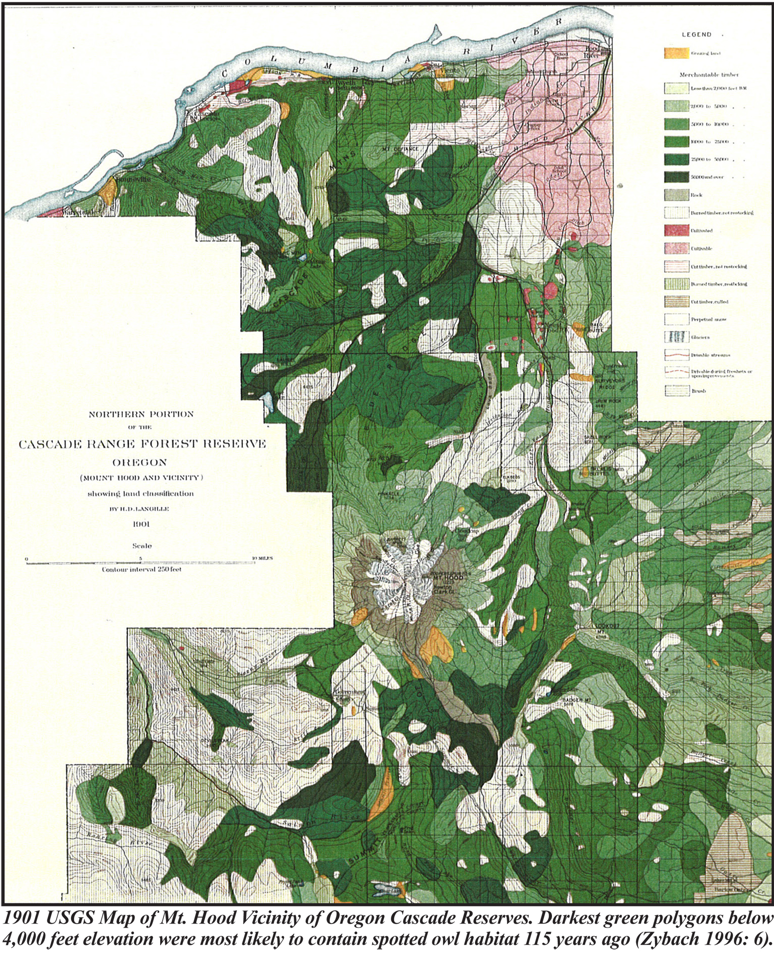

Slide 17
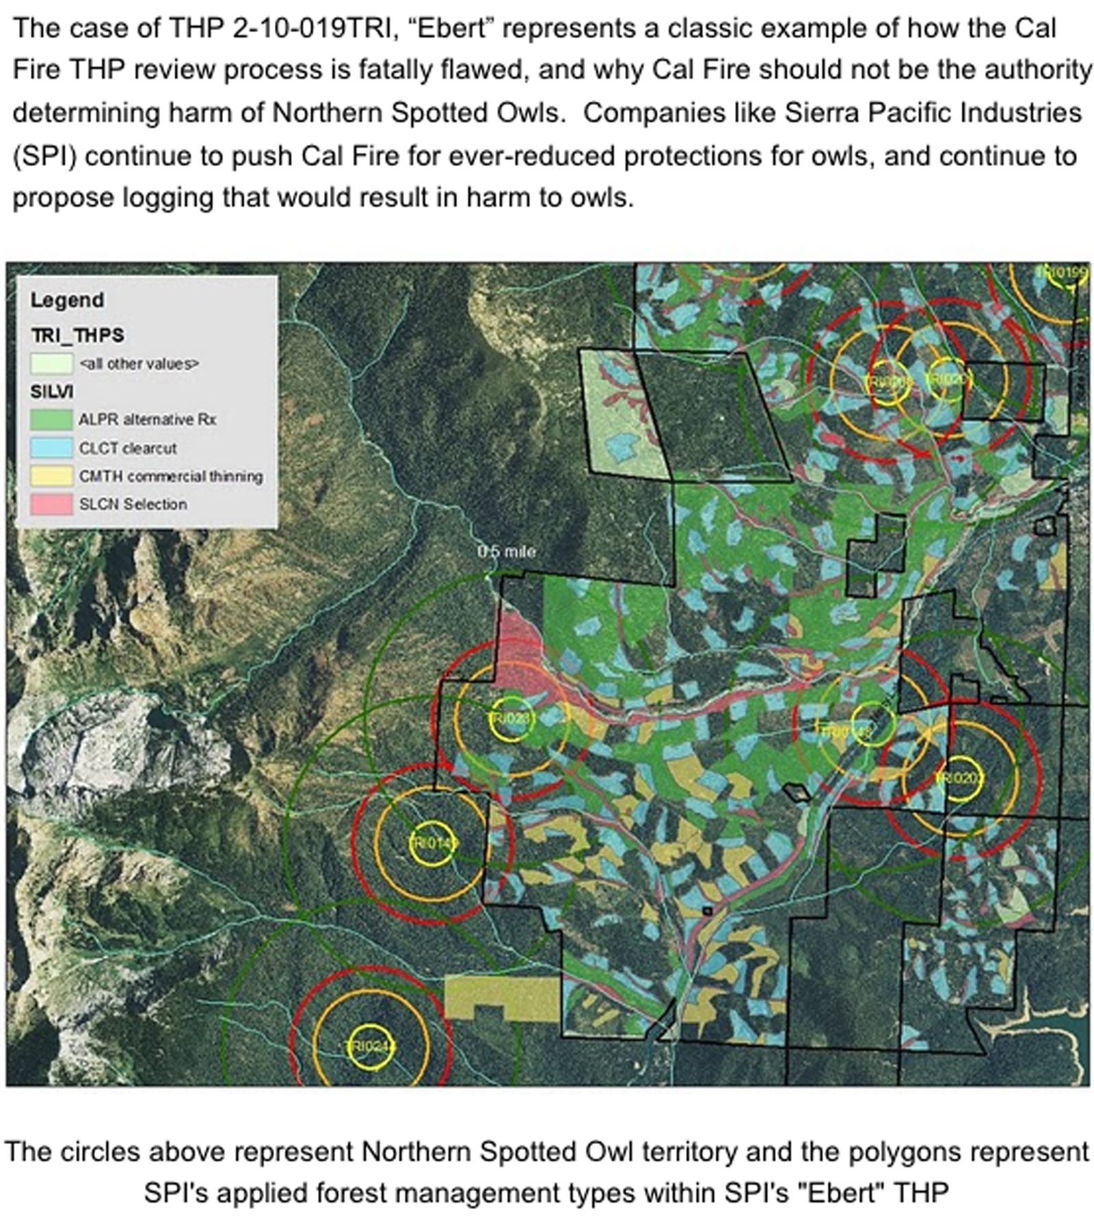

Slide 18
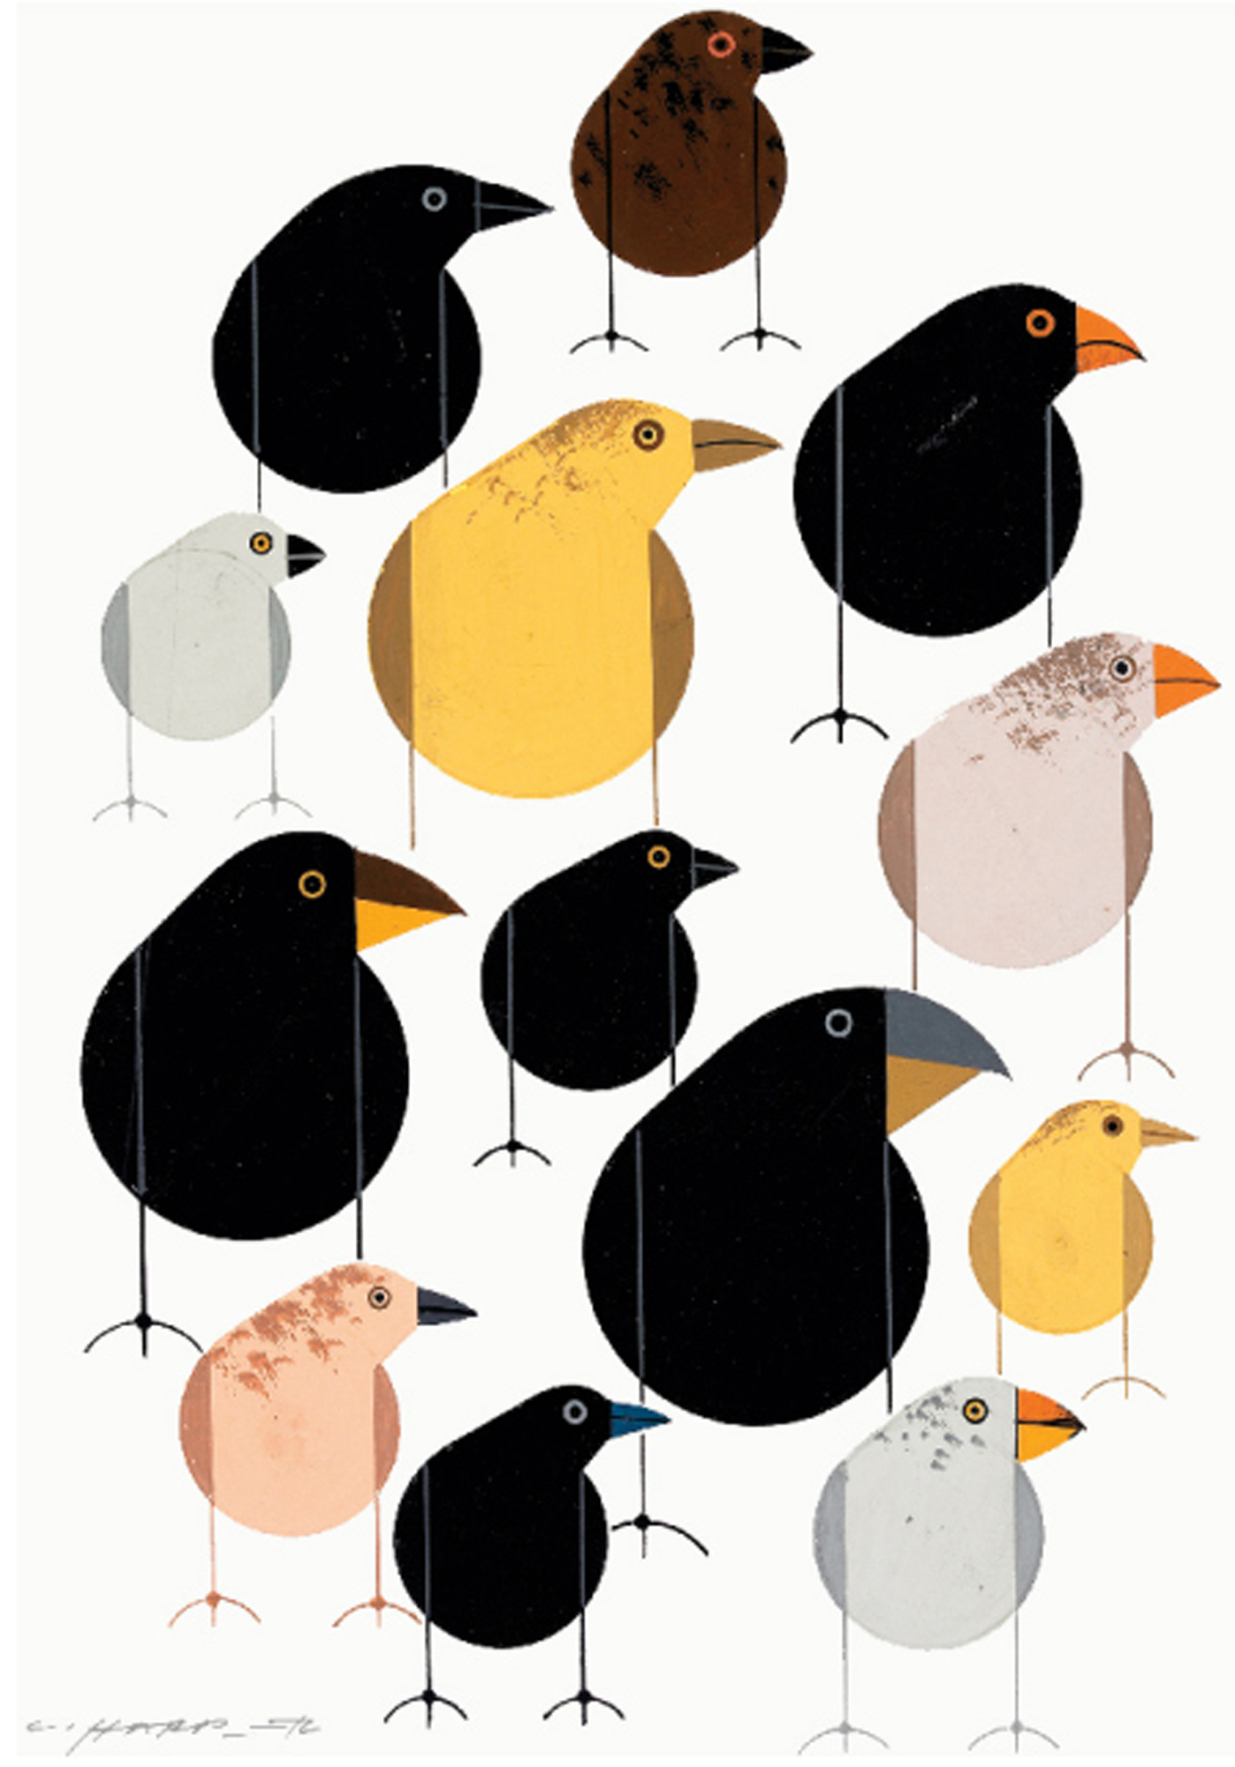
#3. Are Barred Owls a Living Example of “Natural Selection”?
Charley Harper 2010

Slide 19
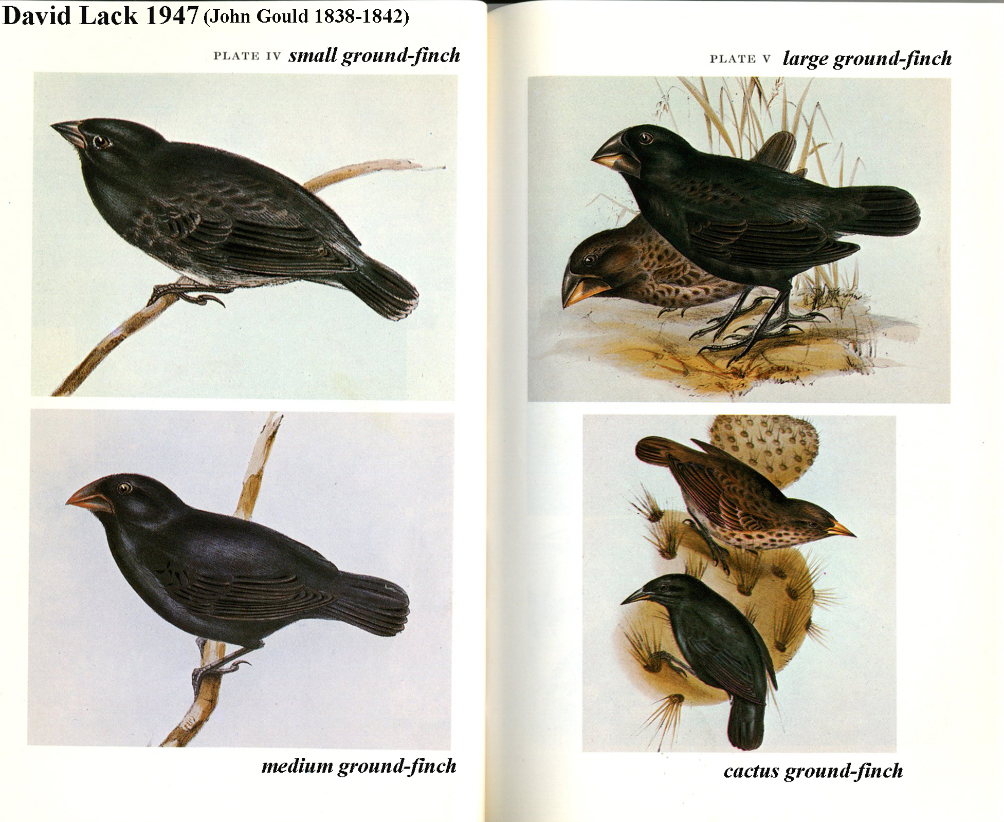

Slide 20
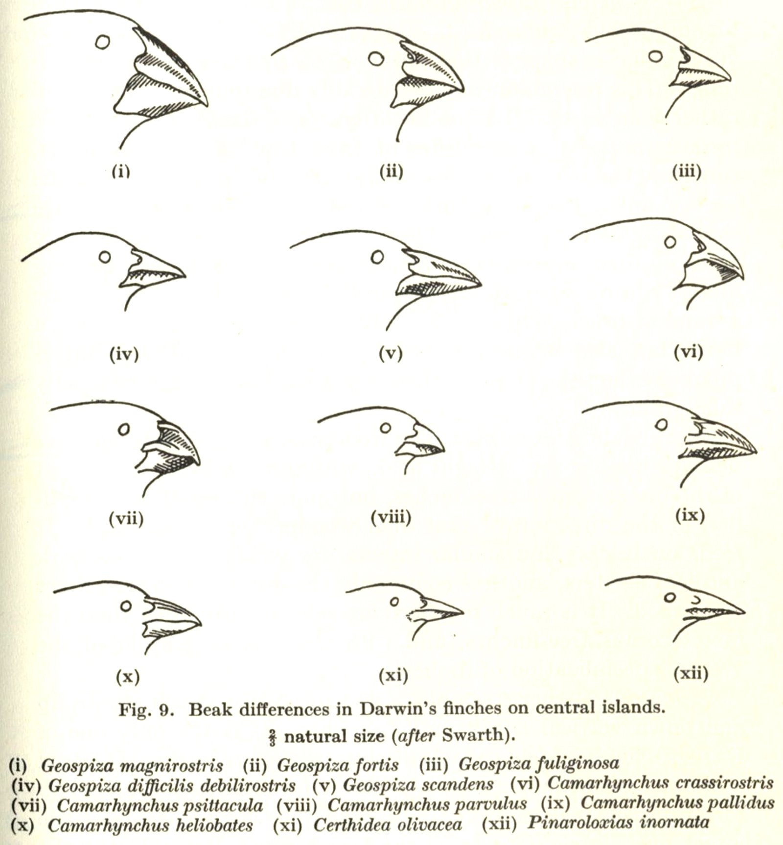

Slide 21
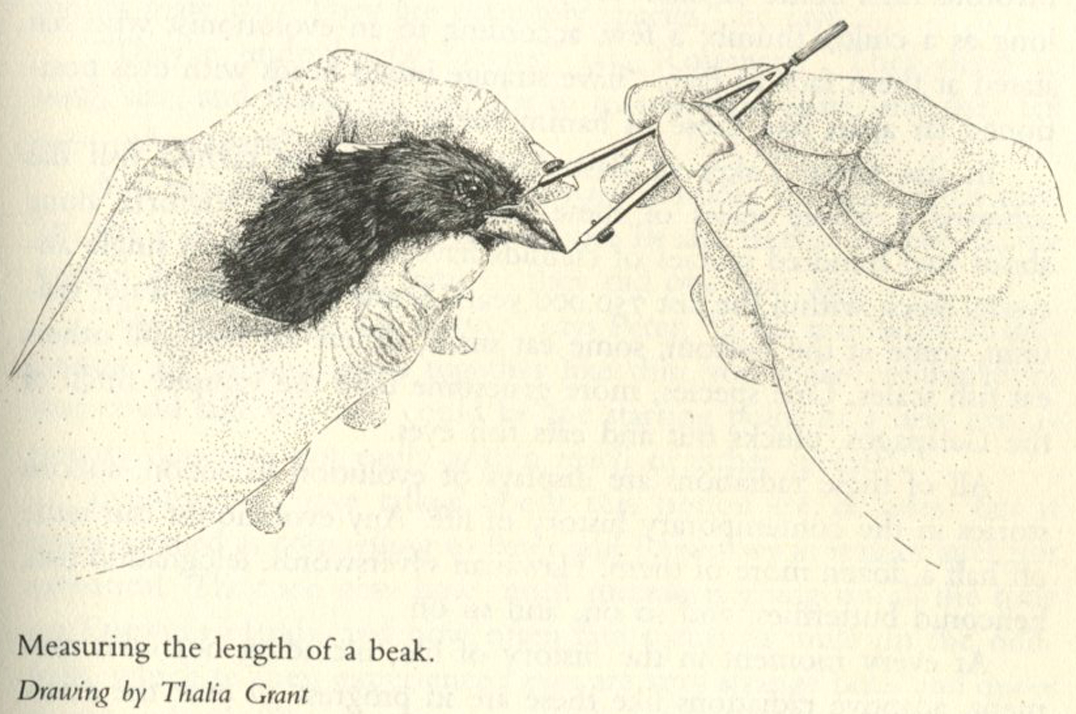

Slide 22
Widely distributed bird species tend to be subdivided into geographical races or
subspecies. The term subspecies has been used rather loosely in some other groups
of animals, so it may be emphasized that in birds it is synonymous with a
geographical race . . . Subspecies of the same species always breed in separate
geographical regions, and where their respective breeding zones adjoin, they often
interbreed freely and intergrade in characters.
-- David Lack, Darwin’s Finches, 1947

Slide 23
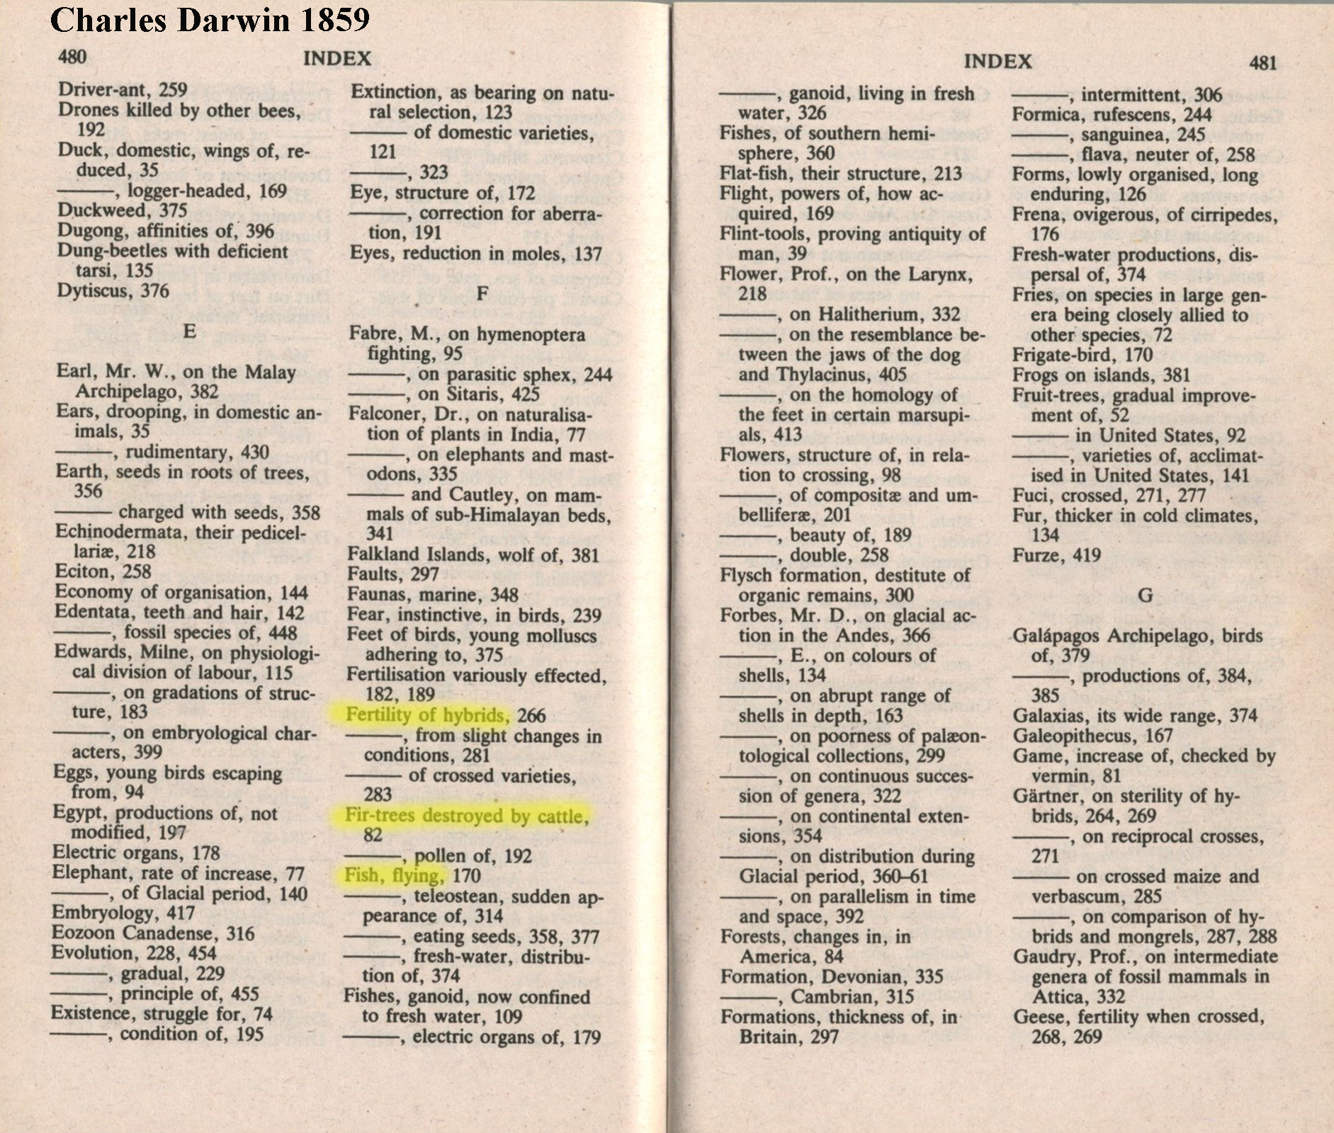

Slide 24
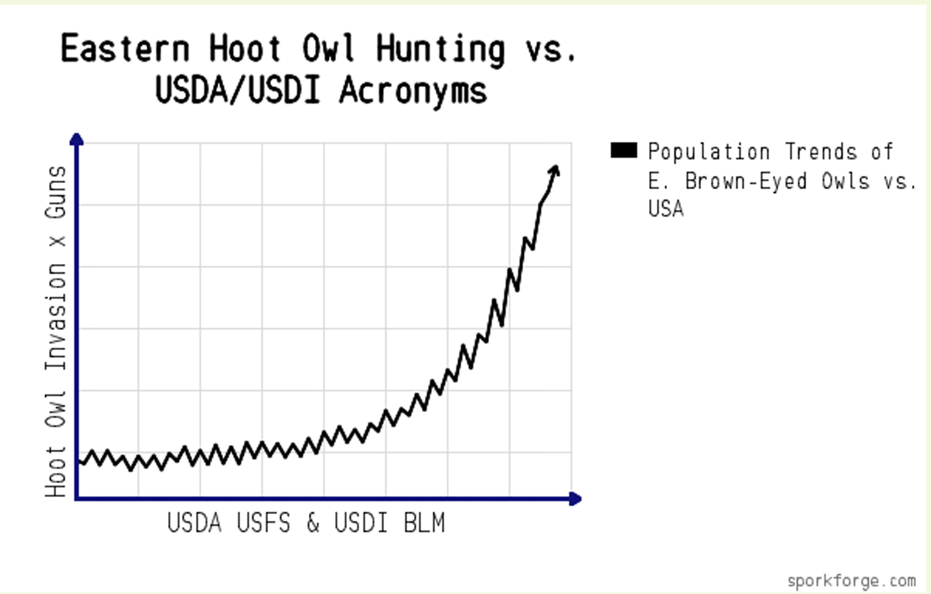
#4. How Reliable are Computerized Predictive Models?

Slide 25
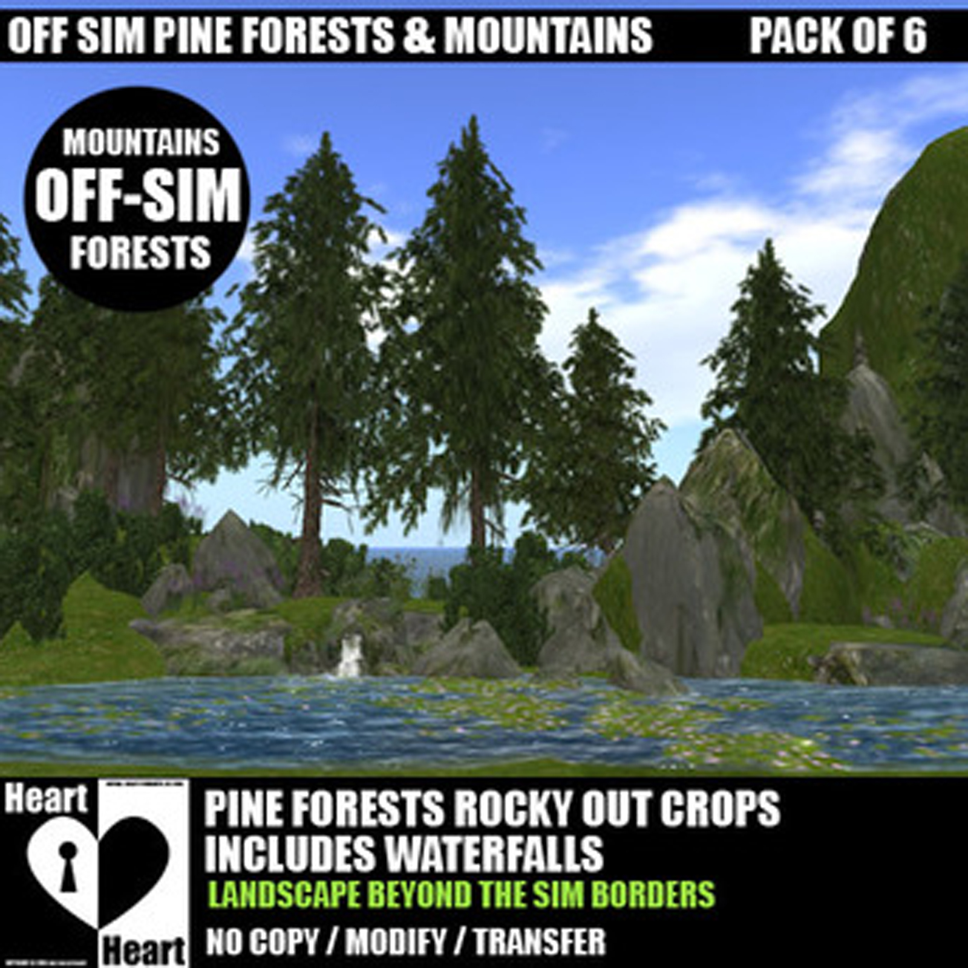

Slide 26
#5. What Do Government Scientists Say About Owl Recovery Plans?

Slide 27
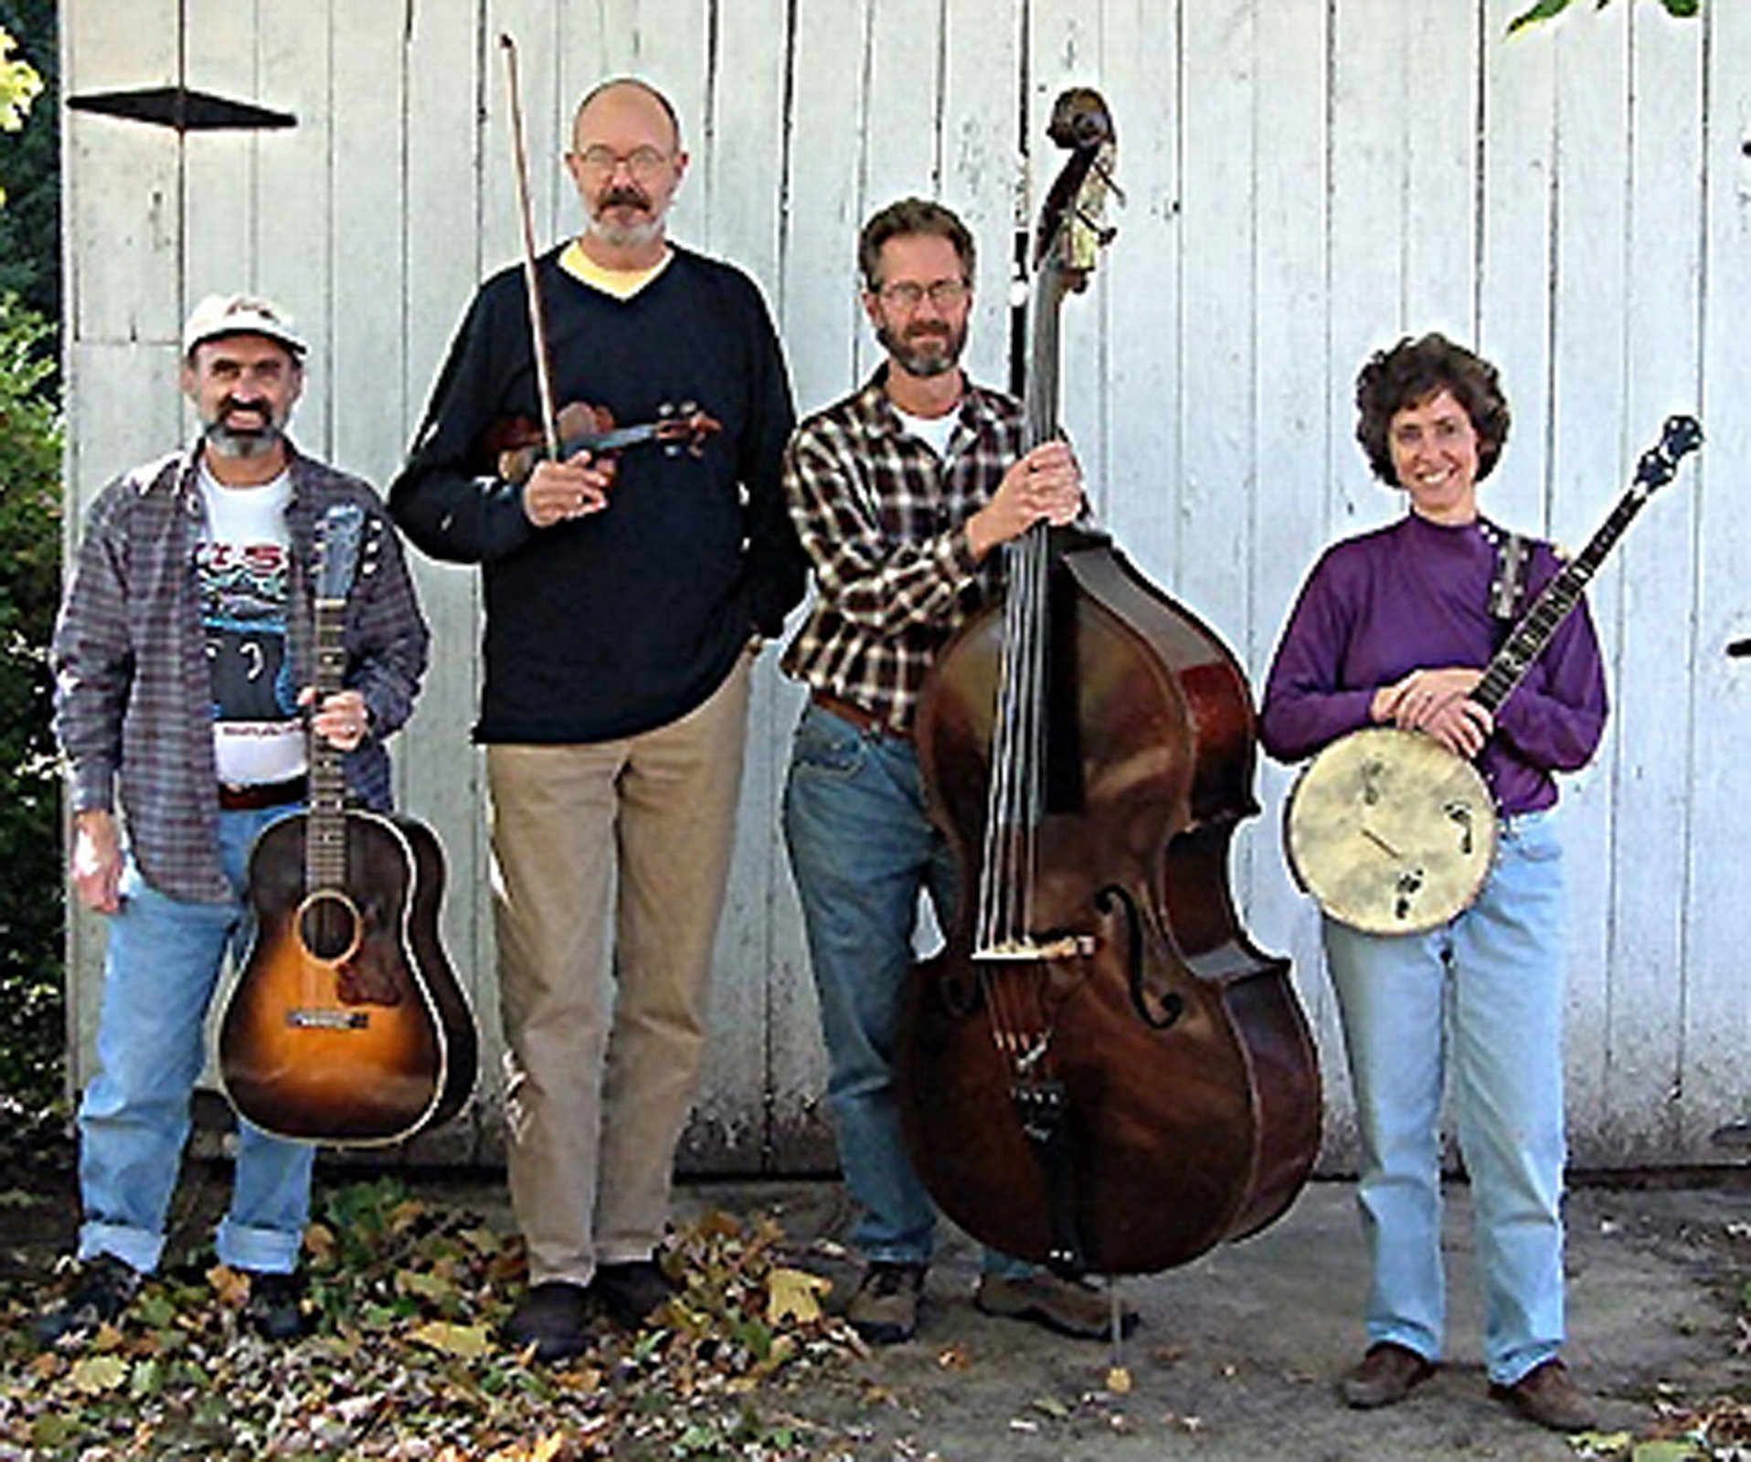

Slide 28
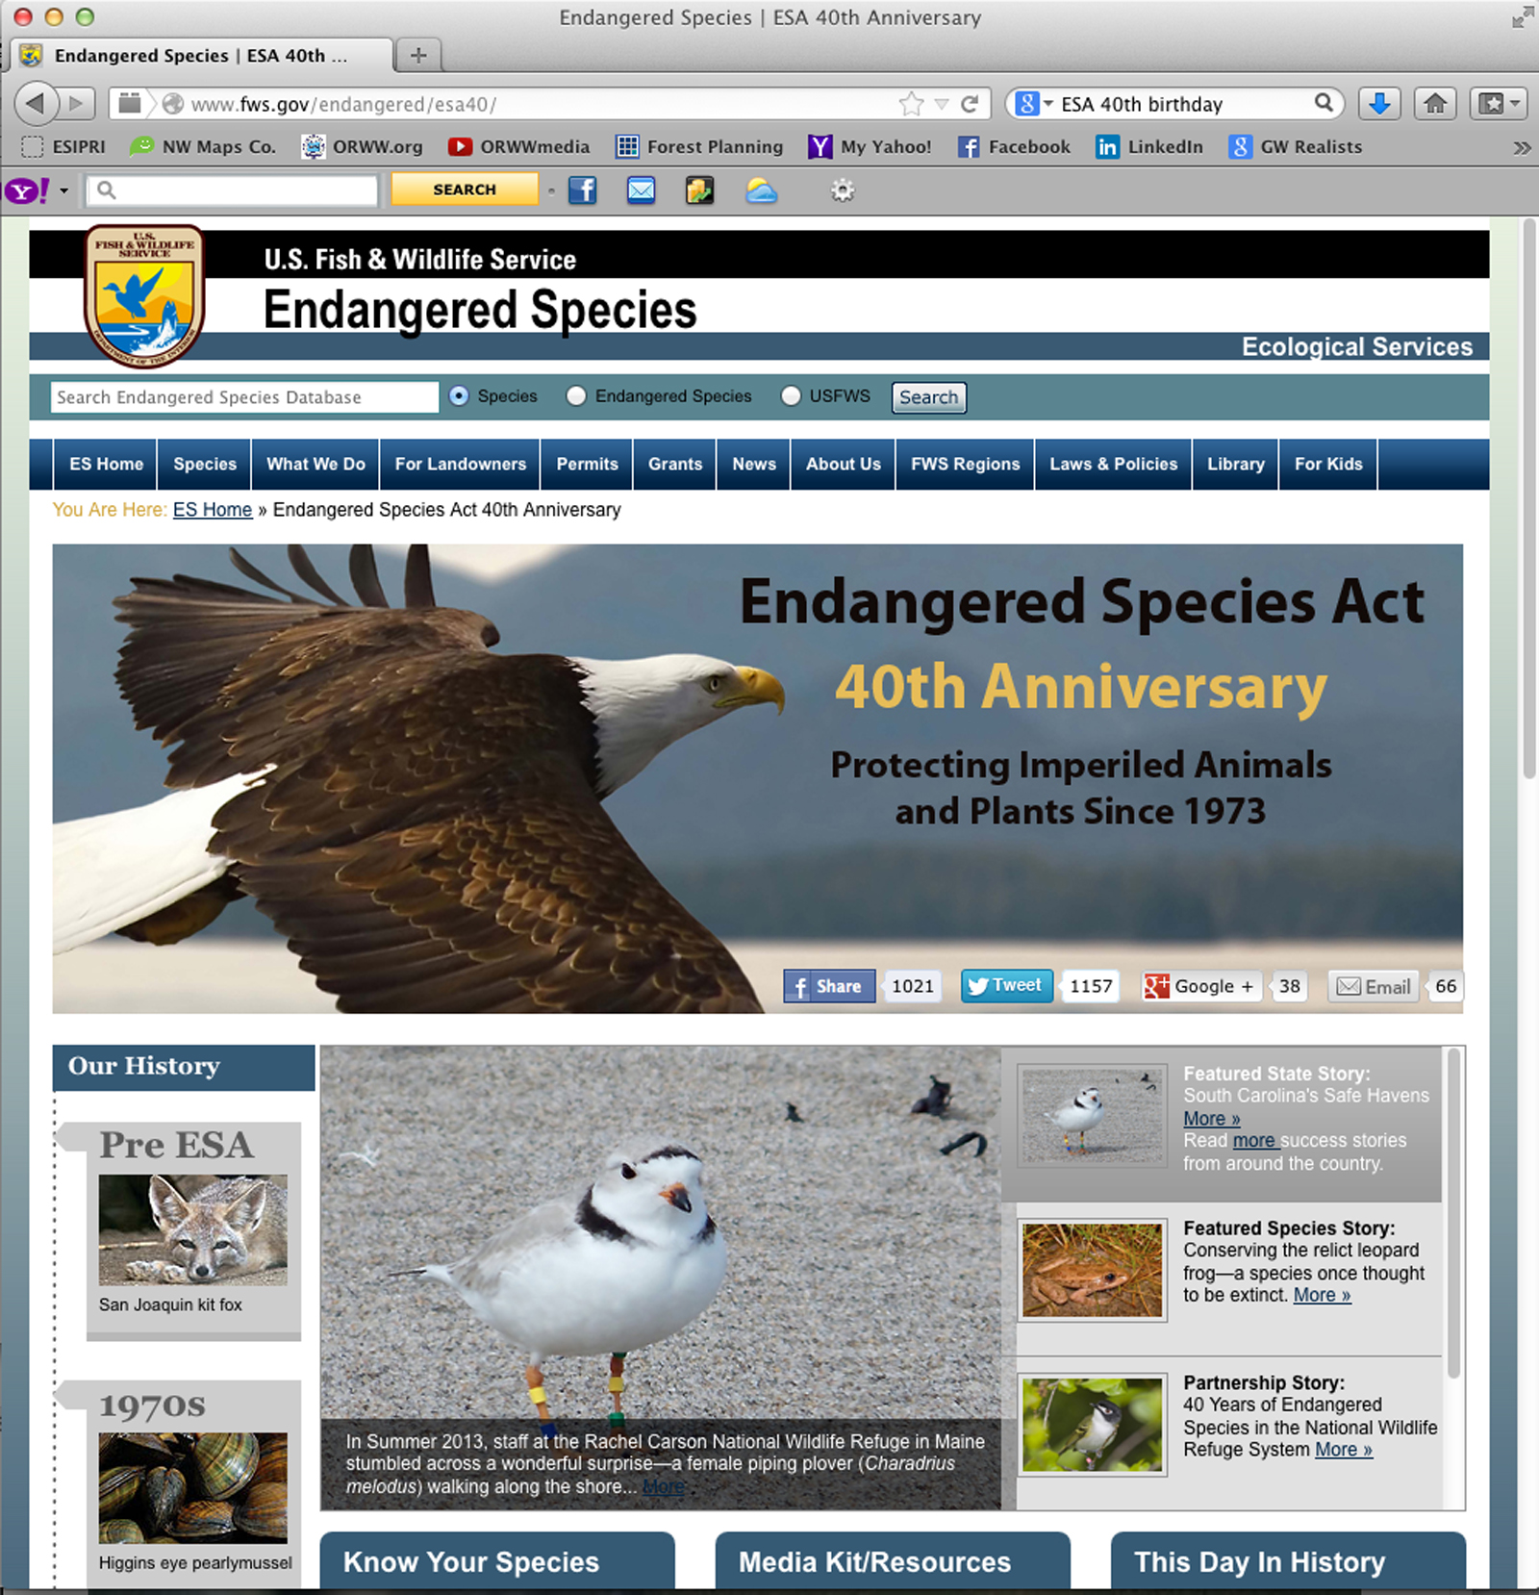

Slide 29
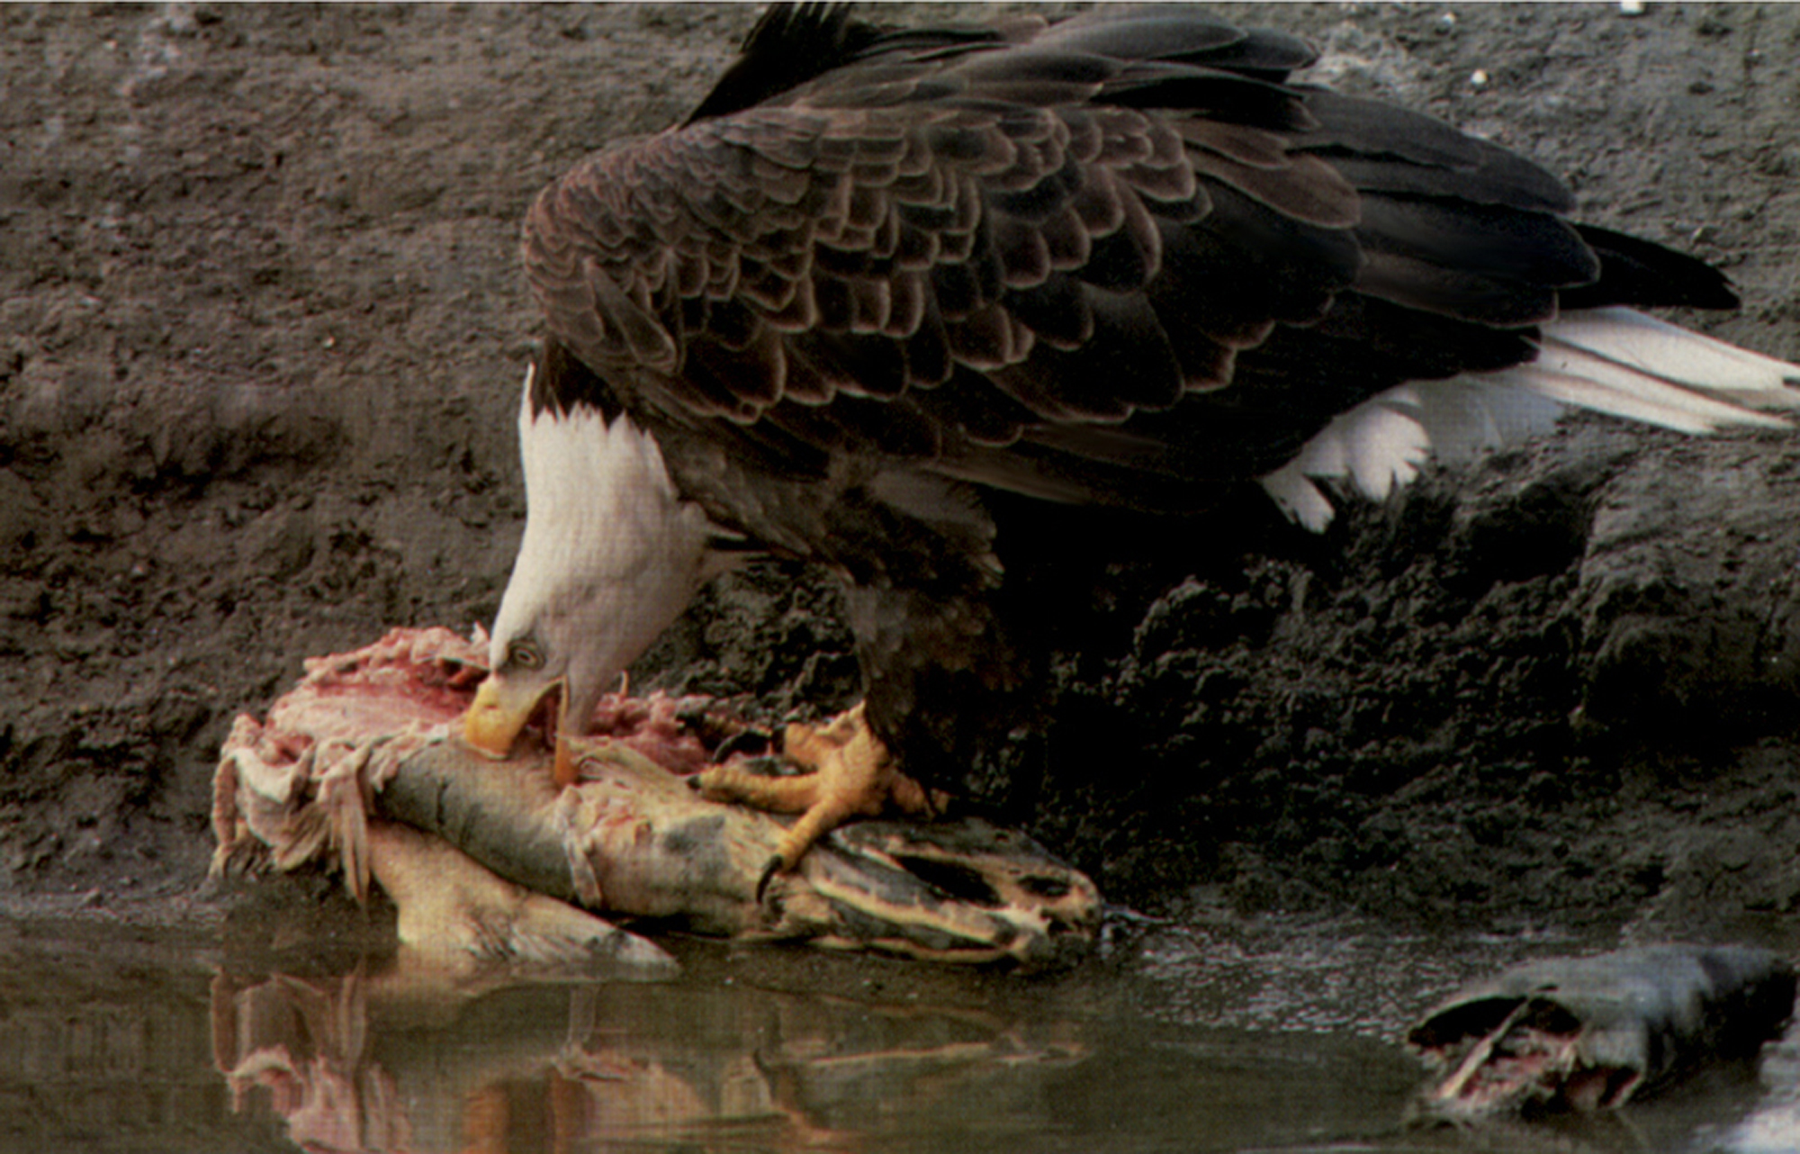

Slide 30
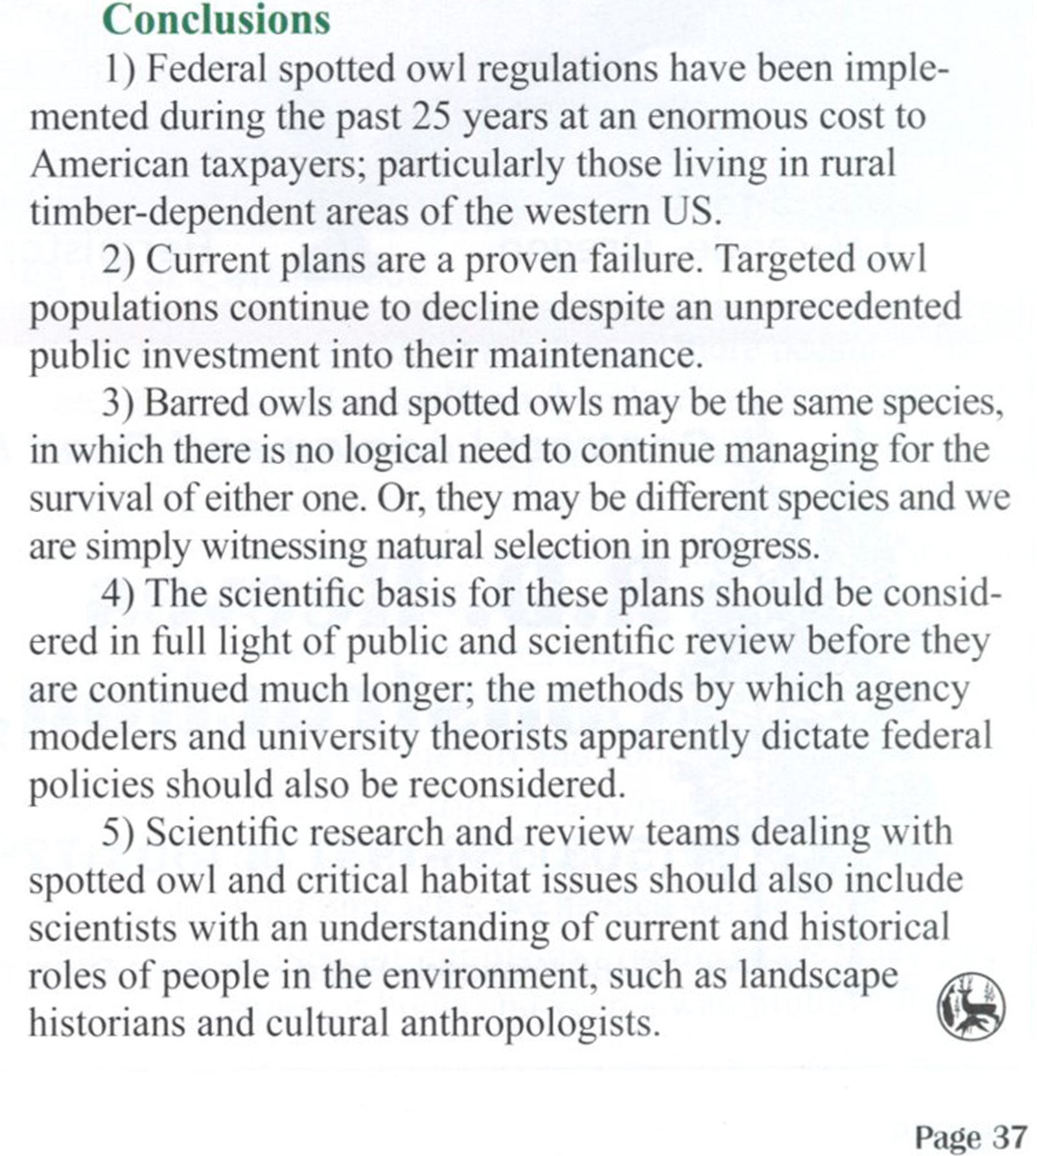

Slide 31
